Slide 1
Banking Industries Effective Market Strategy
By
Mr. B.Thanikaivel
Data analyst, (Role play)
ING bank, (Role play)
Department of Europe. (Role play)

Slide 2
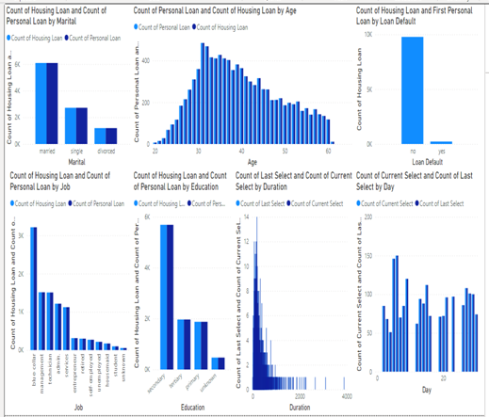
Graphical inference for targeting customers

Slide 3
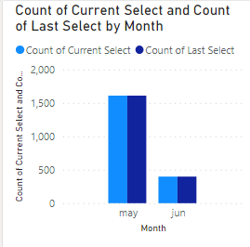
Inference
To target customer
Married
Blue-collar
Secondary educated
Age-30-33
Loan default-No
Telemarketing style
Consequetive days in correct month (example in sample1 is May)
Duration of current select is to be reduced (to get customer interest)

